Slide 1
Undergraduate Diversity at Evolution 2010
Futures Discussion
Maria E. Orive
University of Kansas

Slide 2

Brilliant Insights into Career Options and Training in Evolutionary Biology
?

Slide 3
5 Things I Thought Were True About
“A Future in Evolutionary Biology”
(and how I was completely wrong)

Slide 4
(1) There is only one possible career in evolutionary biology (and my advisor has it).

Slide 5
Genetics
Ecology
Zoology
Physiology
Math
Microbiology
Botany
Evolutionary biology
Computational
Biology-genomics
proteomics
USDA/EPA/
Forest Service
Public health
Epidemiology
Conservation
biology
Agro-ecology
Pharmaceutical
industry
Academics
Teaching
Museums

Slide 6
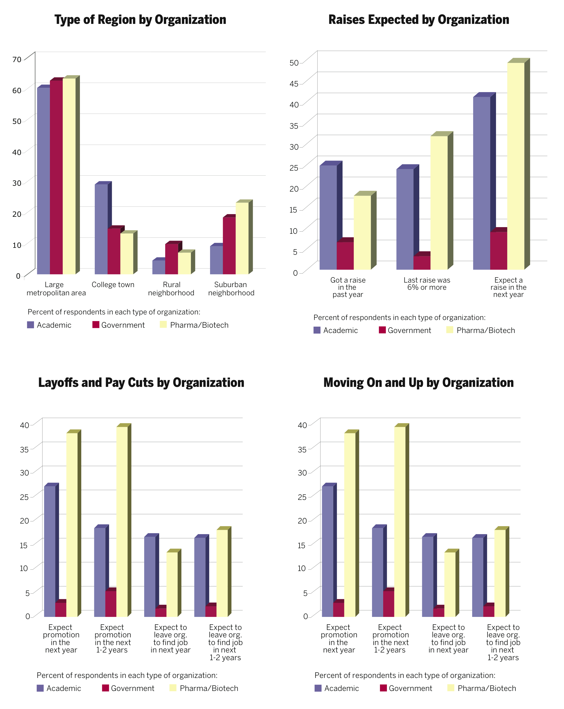
from Genome
Technology,
June 2010
survey of 1640
readers

Slide 7
(2) The working life of a scientist is a lonely existence (and naturally leads to becoming a social outcast).

Slide 8
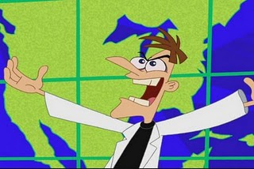
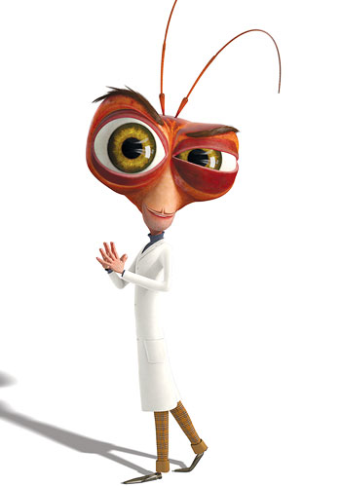

Slide 9
(3) When I’m done with graduate school, I will know all the stuff I need to know (and I’ll stop being a student).

Slide 10
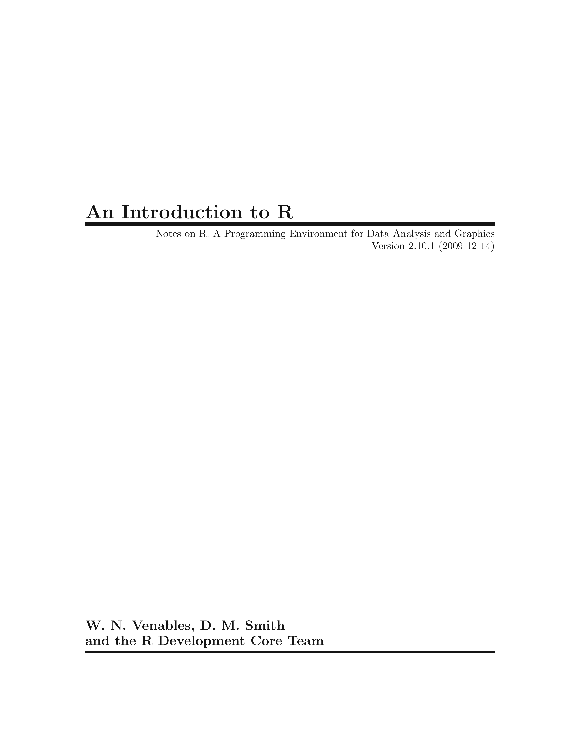

Slide 11
(4) Only theoreticians and other odd ducks need to know quantitative stuff (or, biology is the science with no math).

Slide 12
Stuff my friends know (that I wish I knew more about):
Phylogenetic methods
More statistics (especially multivariate analysis)
R, PERL (and lots of others)
Bioinformatics (especially sequence analysis)

Slide 13
(5) Family + science = impossible (and other untrue equations about life).

Slide 14
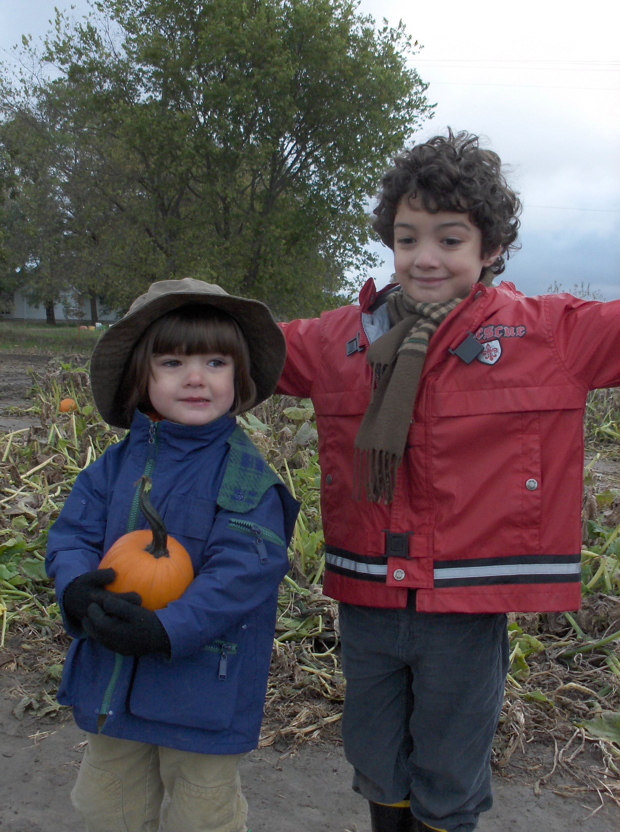

Slide 15
5 Things You Thought Were True About
“A Future in Evolutionary Biology”
(and how you were completely wrong)

Slide 16
Thanks to:
NSF
Scott Edwards
Richard Kliman
NESCent
  Brian Wiegmann
  Jory Weintraub

